Slide 1
Technical Processes
Interactive Media
Unit 1

Slide 2
Starter – 5 Minutes
On your whiteboards, answer the following:
How would a developer show a non-technical member of staff the steps they will follow to make the product?
How would you discover and solve the risks within a project?

Slide 3
Learning Outcomes
Understand the purpose of different technical planning processes.
Describe how the technical processes effect development.
Explain why certain technical processes are used instead of others.

Slide 4
Technical Processes
The technical processes refer to those that focus less on the actual creative content and more on the practical content, e.g. the layout.
Another term frequently used for technical diagrams are visualisation diagrams.

Slide 5
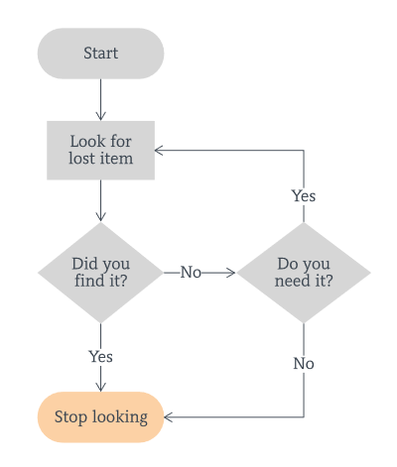
Flowcharts
One of the most commonly used diagrams is the flowchart.
This helps visualise the steps taken to reach the end of a project.
A flowchart should cover every route to get from the starting point to the final product.

Slide 6
Using Flowcharts
Producing flowcharts can be time-consuming, however, they are often useful in highlighting oversights in the development process.
When working with a client, it is key that you can get the information across to them. Often, clients won’t be technical staff, so other means of getting the information across are necessary.

Slide 7
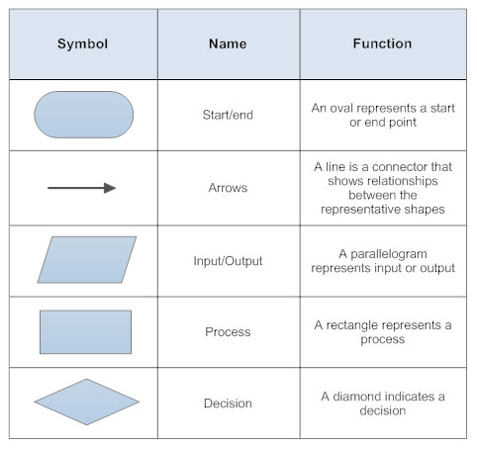
Flowchart Parts

Slide 8
Task 1 – Quick Flowchart
Produce a flowchart that outlines the steps for creating a website. Use MS Visio, then copy the flowchart into your portfolio.
Use start/stop and actions
Use decisions
Use input/output

Slide 9
Portfolio Setup
Create a new heading in your portfolio: Technical Processes (Heading 1).
Create another heading:
Flowcharts (Heading 2)
Wireframes (Heading 2)

Slide 10
Risk Analysis
Risk analysis is the process of identifying and mitigating the potential risks within the development of a project.
The purpose of this is to generate a list of potential problems from the project, to help avoid them.
For example, when creating a product for a younger audience, it is vital to ensure that the imagery and text are all appropriate for that target audience.

Slide 11
Wireframes
Another visual method of presenting information is to use a wireframe.
The purpose of a wireframe diagram is to show in a visual way what something might look like.
This can be used for still images and graphics projects such as poster designs and CD/DVD covers.
They can also be used to show the layout of a web page, multimedia display, game scene, character model, comic book layout etc.

Slide 12
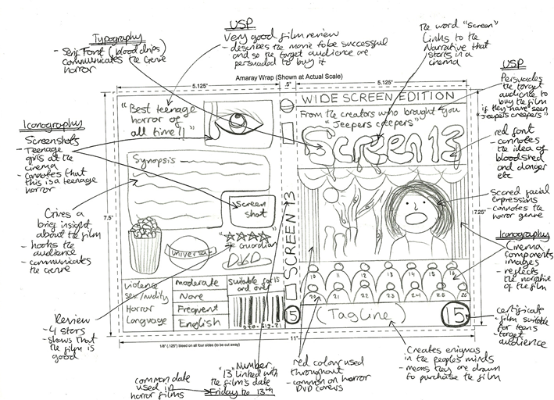
Wireframe Examples
Main background of town,
grey/washout
Arial, bold, 17, red
Faded out background image
TITLE
Sub Title
Pic of town
Pic of town
Pic of town
Oval images of town, glowing, blended in to background image.

Slide 13
What Should be Included?
A wireframe diagram will show both the content and the positions of different elements, such as:
Images
Graphics (Background style, borders)
Text (Font style, size and colour)
Navigation (Location and style of buttons or menus)

Slide 14
Brief – The Haunting of Attercliffe
You are working with a local movie production company.
They would like you to put together a wireframe for a poster (not an actual poster) for their upcoming movie, “The Haunting of Attercliffe”.
This is a horror movie that will focus on a haunted building in the area.

Slide 15
Task 2 – Wireframe
Create a wireframe diagram for a movie poster called “The Haunting of Attercliffe”:
Include text, images and a range of colours.
Include font size/style, why you’ve picked those styles.
Include dimensions for the objects.
Include reasoning for each decision you’ve made on the design.

Slide 16
Plenary – Quick Questions
Make sure your portfolio answers the following questions.
If it doesn’t already, make sure to add these answers.
What is a wireframe diagram? Why is it used?
What is a mood-board? What is it made up of?
What is the purpose of the technical processes?
Why might you use a flowchart but not a wireframe?

